Slide 1


Major Project 2
Heart Disease Prediction Using Machine Learning with Python
Presented by Ujjwal Pandey (0111AL211173) , Shivendra Patel (0111AL211155) , Sonu Kumar Prajapati (0111AL211162) , and Yasir Ali (0111AL211186) .
Explore the project's workflow and machine learning application for heart disease prediction.

Slide 2

Step 2 – Data Preprocessing
Handling Missing Data
Categorical Encoding
Use imputation or deletion to manage missing values.
Transform categories into numeric via one-hot encoding.
Feature Scaling
Feature & Target Separation
Normalize or standardize numerical features for model efficiency.
Split dataset into predictors and outcome variable.

Slide 3
Q&A – Data Preprocessing
Why Encode Categoricals?
Why Normalize Features?
Handling Missing Values
Models require numeric input for mathematical calculations.
Equalizes scale to improve model convergence and performance.
Deletion
Mean/median imputation
KNN-based methods

Slide 4



Step 3 – Train-Test Split
Typical Ratio
2
80% training set, 20% testing set split.
Purpose
1
Evaluate model on unseen data to check generalization.
Implementation Tool
train_test_split function from scikit-learn.
3

Slide 5

Step 4 – Logistic Regression
Evaluation Metrics
Process
Accuracy
Use Case
Initialize model, train on data, and assess performance.
Precision
Binary classification to detect heart disease presence.
Recall
F1 Score

Slide 6
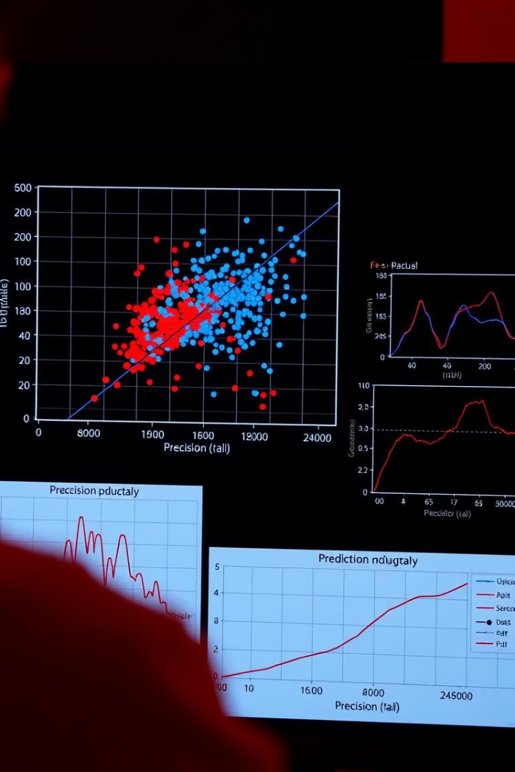


Q&A – Model Prediction
Making Predictions
Preprocess data identically, then apply model.predict()
Model Evaluation
Use metrics along with confusion matrix and ROC-AUC curves.

Slide 7

ECG Features and Importance
Resting ECG
Baseline heart activity measurement.
Max Heart Rate (thalach)
Maximum achieved during exercise stress test.
Exercise-induced Angina (exang)
Chest pain triggered by physical exertion.
ST Depression and Slope
Indicators of ischemia seen in ECG waveform.

Slide 8
Parameters Used in Prediction
Total Features
Notable Features
14 clinical and diagnostic parameters used.
ca: Major vessels via fluoroscopy
thal: Normal/fixed/reversible defects
target: Health status (0 = healthy, 1 = unhealthy)

Slide 9

Conclusion & Tools Used
Platform
Dataset Reference
Google Colab enabled collaborative coding and execution.
Publicly available UCI dataset hosted on Kaggle.
Team Effort
Joint work in research, coding, and comprehensive documentation.
Thank you for your attention and interest in this project.

